Slide 1
1.5 CLE CREDITS (1.0 GENERAL, 0.5 ETHICS)
The Drunk History Litigation Challenge
Revisiting legally significant events.

Slide 2



THE CONCEPT
Team Formation
Hon. Peter Sala
Robert Catalde
Ashley Solo
Select 2 additional members.
Select 2 additional members.
Select 2 additional members.

Slide 3
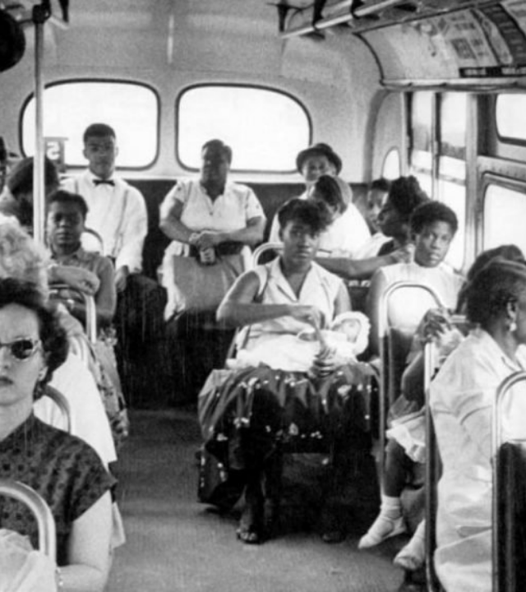
ROUND 1: 1955
Civil Rights Strategy
01. Named Plaintiff: Rosa Parks or Claudette Colvin?
02. Forum: Select jurisdiction
03. Constitutional Grounds: Assert protections.

Slide 4
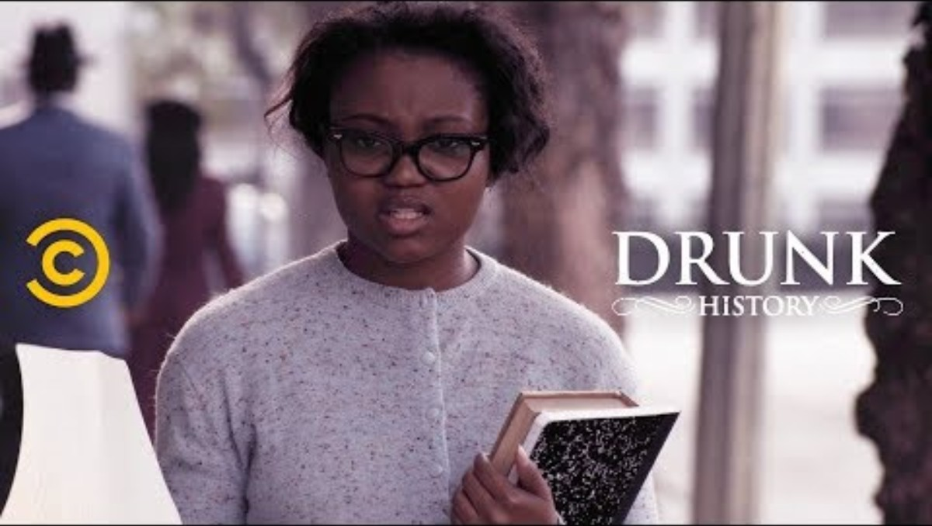

Slide 5
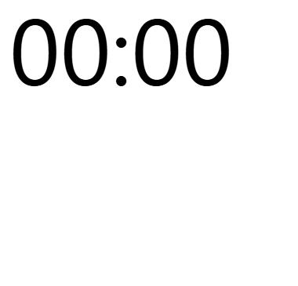
ROUND 1: 1955
Civil Rights Strategy
1
Which plaintiff do you choose to be one of the named plaintiffs in your lawsuit, Rosa Park or Claudette Colvin?
2
What legal forum do you select? Specifically, Atty. Grey is challenging both Alabama statutes and City of Montgomery ordinances -- does your response change if just one and not the other?
3
And what constitutional grounds do you assert?

Slide 6
ROUND 1: 1955
Civil Rights Scoring
5
5
5
10
Correct Plaintiff
Correct Forum
Equal Protection
Best Explanation

Slide 7
ROUND 1: 1955
TEAM SALA | TEAM CATALDE | TEAM SOLO
15 | 10 | 10

Slide 8
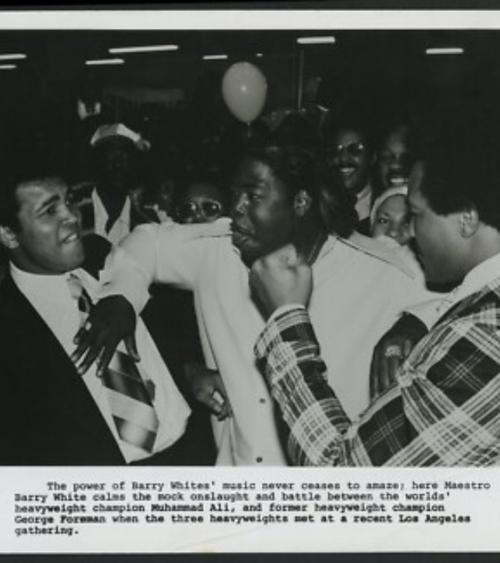
ROUND 2: 1971
The Appellate Rescue Mission
Clay v. United States
Act as Supreme Court Justices.
Listen to the record summary.
Identify reversible errors.

Slide 9
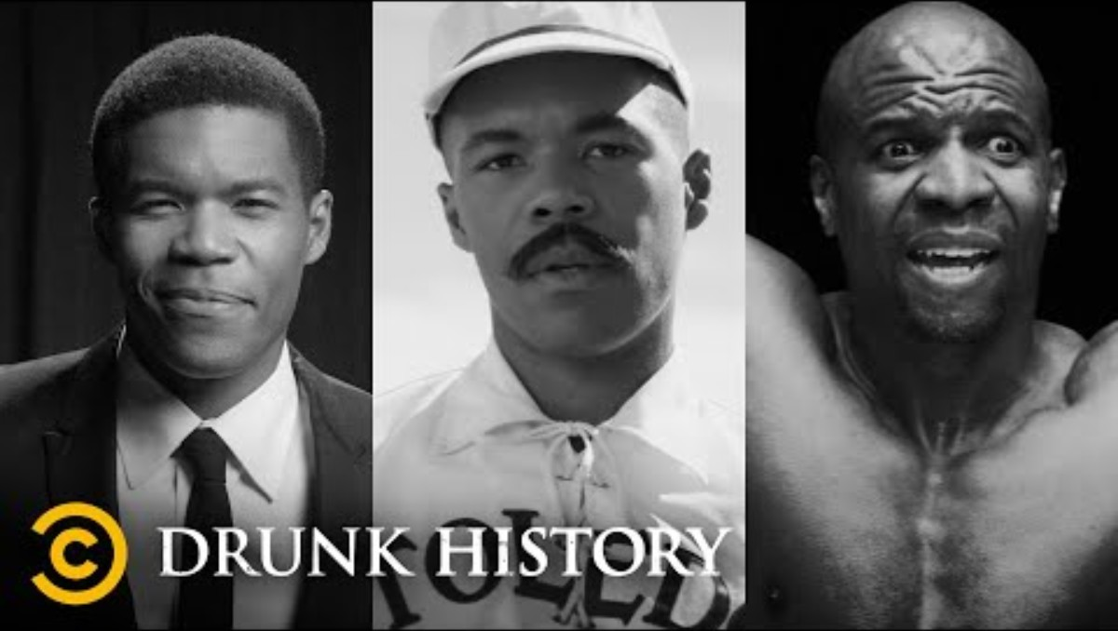

Slide 10
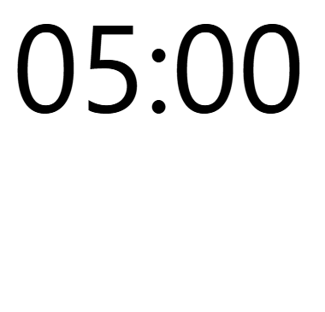
ROUND 2: 1971
Appellate Rescue Mission
1
Identify the reversible error(s).
Reversible Error: "An error that affects a party's substantive rights or the case's outcome, and thus is grounds for reversal if the party properly objected at trial.“
– Black’s Law Dictionary

Slide 11
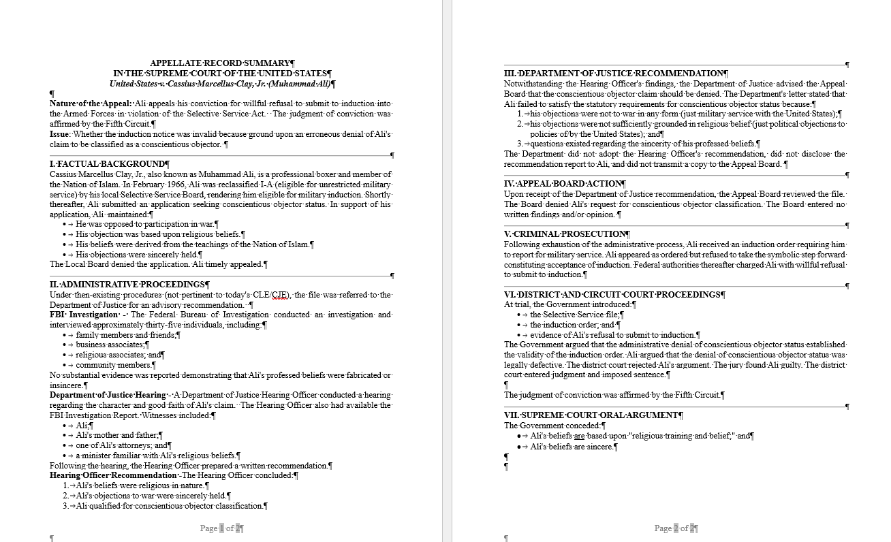

Slide 13
ROUND 2: 1971
Appellate Error Scoring
5
DOJ Advisory Letter/Lack of Factual Findings
5
Appeal Board Decision/Failure to Identify Reason(s)
5
Administrative Defects
10
Most Creative or Humorous Error

Slide 14
ROUND 2: 1971
TEAM SALA | TEAM CATALDE | TEAM SOLO
20 | 15 | 15

Slide 15
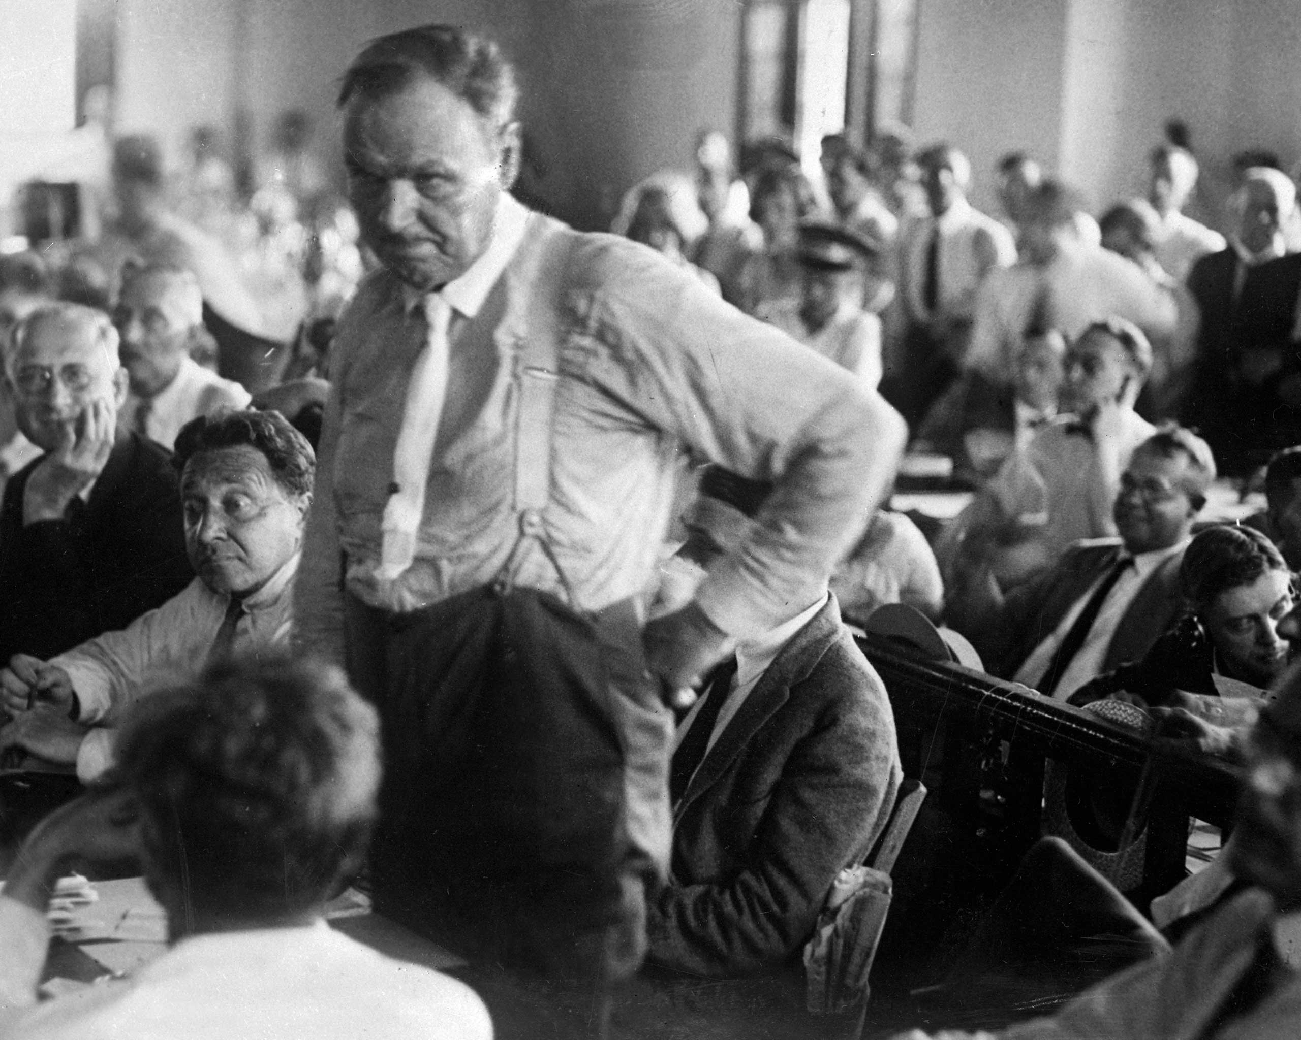
ROUND 3: THE SCOPES MONKEY TRIAL
Would You Be Disciplined?

Slide 16
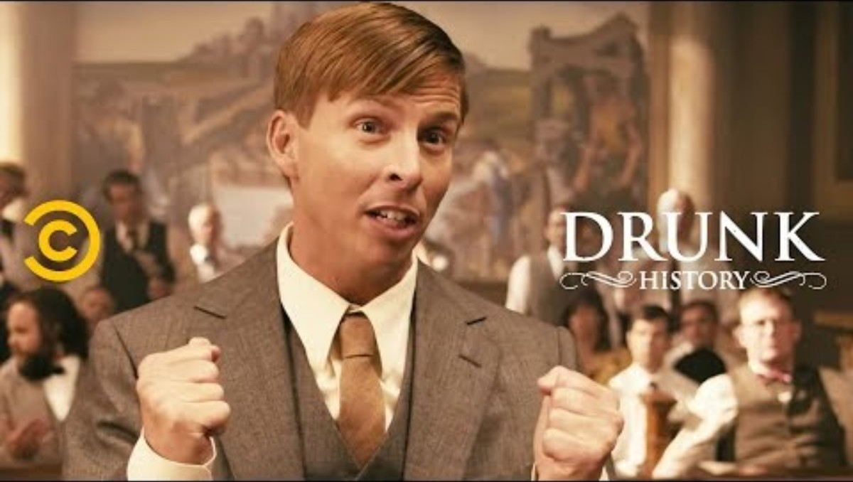

Slide 17
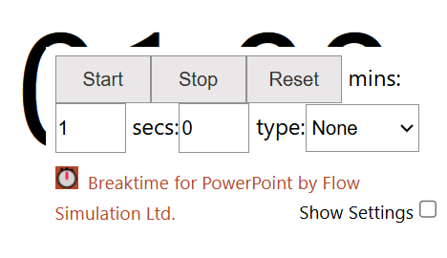
ROUND 3: THE SCOPES MONKEY TRIAL
Would You Be Disciplined?
SCENARIO 1
You intentionally create a test case solely to gain publicity for your law firm.
Question: Is this ethical?
Yes, no, or maybe/depends?
And what is the applicable rule?

Slide 18
Rule of Professional Conduct 3.1
Meritorious Claims and Contentions
A lawyer shall not bring or defend a proceeding, or assert or controvert an issue therein, unless there is a basis in law and fact for doing so that is not frivolous, which includes a good faith argument for an extension, modification or reversal of existing law. A lawyer for the defendant in a criminal proceeding, or the respondent in a proceeding that could result in incarceration, may nevertheless so defend the proceeding as to require that every element of the case be established.

Slide 19
Pennsylvania Code of Judicial Conduct Rules 2.2 and 2.5
2.2 Impartiality and Fairness
2.5 Competence, Diligence and Cooperation
Rule 2.2. Impartiality and Fairness.
A judge shall uphold and apply the law, and shall perform all duties of judicial office fairly and impartially.
Rule 2.5. Competence, Diligence and Cooperation.
(A) A judge shall perform judicial and administrative duties competently and diligently.
(B) A judge shall cooperate with other judges and court officials in the administration of court business.

Slide 20
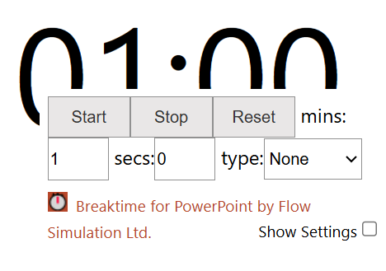
ROUND 3: THE SCOPES MONKEY TRIAL
Would You Be Disciplined?
SCENARIO 2
During a nationally televised trial, you continue giving daily interviews attacking opposing witnesses?
Question: What Rule relates to this decision?

Slide 21
Rule of Professional Conduct 3.6
Trial Publicity
A lawyer who is participating or has participated in the investigation or litigation of a matter shall not make an extrajudicial statement that the lawyer knows or reasonably should know will be disseminated by means of public communication and will have a substantial likelihood of materially prejudicing an adjudicative proceeding in the matter.

Slide 22
Pennsylvania Code of Judicial Conduct Rule 2.10
Judicial Statements on Pending and Impending Cases
(A) A judge shall not make any public statement that might reasonably be expected to affect the outcome or impair the fairness of a matter pending or impending in any court, or make any nonpublic statement that might substantially interfere with a fair trial or hearing.
(B) A judge shall not, in connection with cases, controversies, or issues that are likely to come before the court, make pledges, promises, or commitments that are inconsistent with the impartial performance of the adjudicative duties of judicial office.
(C) A judge shall require court staff, court officials, and others subject to the judge’s direction and control to refrain from making statements that the judge would be prohibited from making by paragraphs (A) and (B).
(D) Notwithstanding the restrictions in paragraph (A), a judge may make public statements in the course of official duties, may explain court procedures, and may comment on any proceeding in which the judge is a litigant in a personal capacity.
(E) Subject to the requirements of paragraph (A), a judge may respond directly or through a third party to allegations in the media or elsewhere concerning the judge’s conduct in a matter.

Slide 23
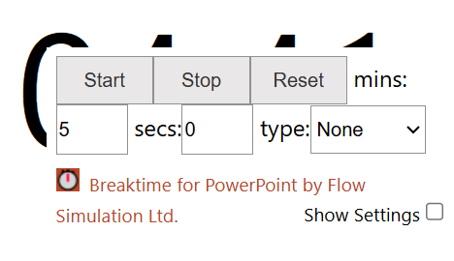
ROUND 3: THE SCOPES MONKEY TRIAL
Would You Be Disciplined?
SCENARIO 3
Trial counsel voluntarily takes the witness stand.
Question: What Rule applies?

Slide 24
Rule of Professional Conduct 3.7
Lawyer as Witness
A lawyer shall not act as advocate at a trial in which the lawyer is likely to be a necessary witness unless:
  the testimony relates to an uncontested issue;
  the testimony relates to the nature and value of legal services rendered in the case; or,
  disqualification of the lawyer would work substantial hardship on the client.
A lawyer may act as advocate in a trial in which another lawyer in the lawyer's firm is likely to be called as a witness unless precluded from doing so by Rule 1.7 [Conflict of Interest – Current Clients] or Rule 1.9 [Duties to Former Clients].

Slide 25
Pennsylvania Code of Judicial Conduct Rule 2.11
Disqualification
Rule 2.11. Disqualification.
(A) A judge shall disqualify himself or herself in any proceeding in which the judge’s impartiality might reasonably be questioned, including but not limited to the following circumstances:
  (1) The judge has a personal bias or prejudice concerning a party or a party’s lawyer, or personal knowledge of facts that are in dispute in the proceeding.
  (2) The judge knows that the judge, the judge’s spouse or domestic partner, or a person within the third degree of relationship to either of them, or the spouse or domestic partner of such a person is:
    (a) a party to the proceeding, or an officer, director, general partner, managing member, or trustee of a party;
    (b) acting as a lawyer in the proceeding;
    (c) a person who has more than a de minimis interest that could be substantially affected by the proceeding; or
    (d) likely to be a material witness in the proceeding.
See also: Rule of Judicial Administration 1701(e): No judge or district justice shall testify voluntarily as a character witness. The provisions of this subdivision shall constitute a canon of ethics for the purposes of Section 17 of the Judiciary Article.

Slide 26
ROUND 3: THE SCOPES MONKEY TRIAL
Would You Be Disciplined Scoring?
SCENARIO 1
SCENARIO 2
SCENARIO 3
Meritorious Claims
Rule 3.1
Trial Publicity
Rule 3.6
Lawyer as Witness
Rule 3.7
Intentionally creating a test case solely for publicity.
Giving daily television interviews attacking opposing witnesses.
Trial counsel voluntarily takes the witness stand.
5
5
5
POINTS
POINTS
POINTS
5
Most Unethical Team:
POINTS

Slide 27
ROUND 3: THE SCOPES MONKEY TRIAL
TEAM SALA | TEAM CATALDE | TEAM SOLO
0 | 0 | 0

Slide 28
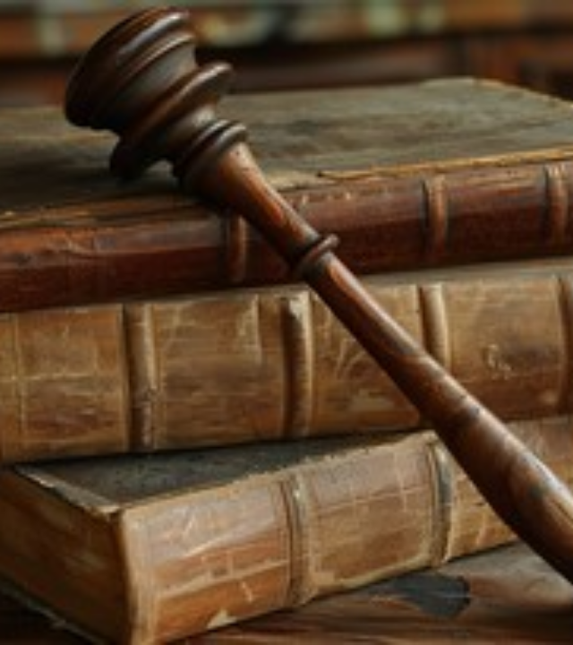
FINAL ROUND: 1510 FRANCE
Trial of the Rats
Should the rats be compelled to appear?
1. Notice
2. Jurisdiction
3. Due Process

Slide 29
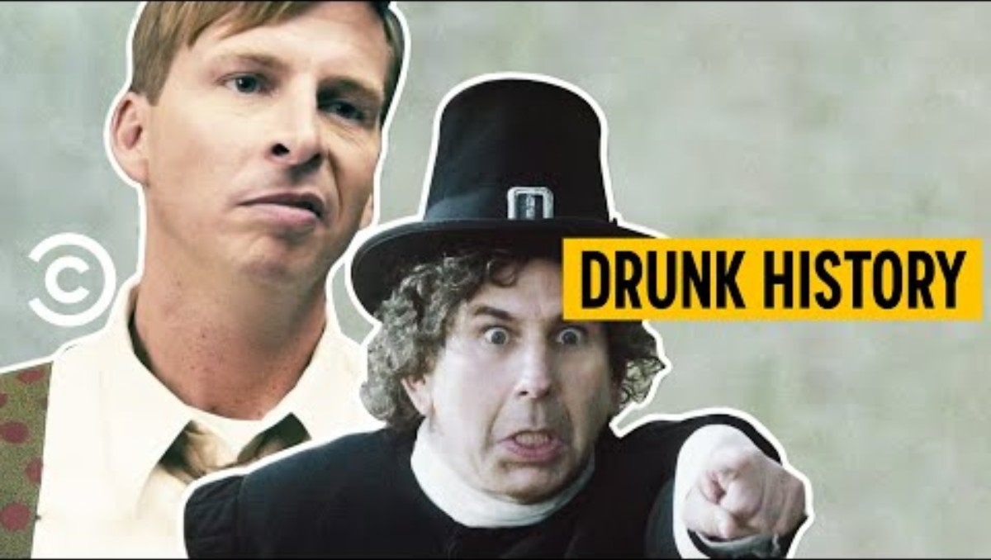

Slide 30
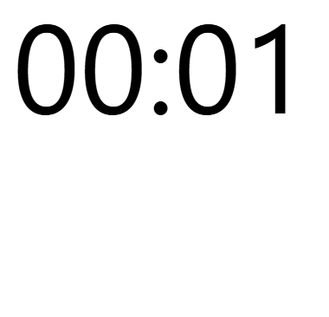
FINAL ROUND: 1510 FRANCE
Trial of the Rats
1
Teams are asked to take a position on whether the rats should be compelled to appear.
2
Why or why not (discussing notice, jurisdiction, and due process in their reasoning)?

Slide 31
FINAL ROUND SCORING
10
10
Most Historically Accurate
Most Compelling Argument

Slide 33
FINAL ROUND SCORING
10
10
Most Historically Accurate
Most Compelling Argument

Slide 34
FINAL ROUND: 1510 FRANCE
TEAM SALA | TEAM CATALDE | TEAM SOLO
0 | 0 | 0

Slide 35

The Final Verdict

